Slide 1


Slide 2

WHAT IS ARTIFICIAL INTELLIGENCE? &
MACHINE LEARNING? – Part #1

Slide 3
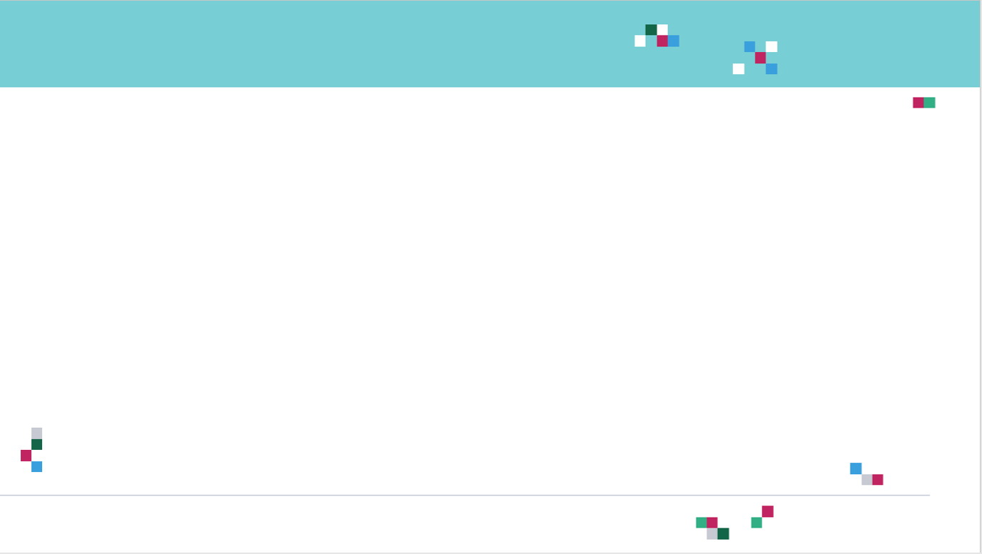
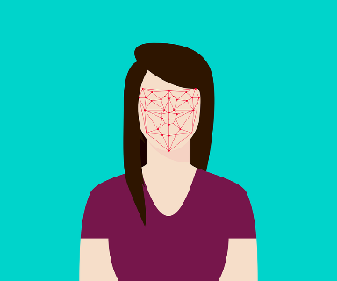
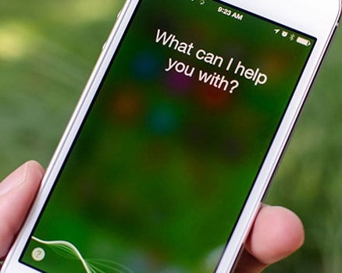

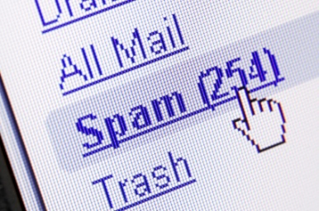
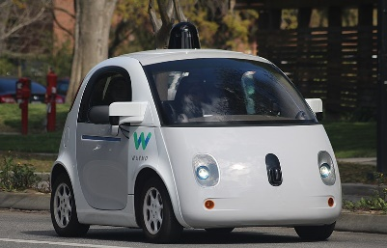

INTRODUCTION
Artificial Intelligence/Machine learning does not only mean robots or Sci-Fi movies!
Machine and deep learning applications are everywhere!
Google search engine, amazon recommender systems, Facebook facial recognition (tagging), Siri.
Photo Credit: https://commons.wikimedia.org/wiki/File:Waymo_self-driving_car_front_view.gk.jpg
Photo Credit: http://blog.etonic.net/index.php?entry=entry110316-081129
Photo Credit: https://www.flickr.com/photos/topgold/8325104250
Photo Credit: https://picryl.com/media/google-search-engine-magnifying-glass-computer-communication-00b825
Photo Credit: https://www.flickr.com/photos/iphonedigital/26988770454
Photo Credit: https://pixabay.com/illustrations/flat-recognition-facial-face-woman-3252983/

Slide 4
MACHINE LEARNING COMPONENTS?
1. DATA
2. MODEL
3. COMPUTE

Slide 5
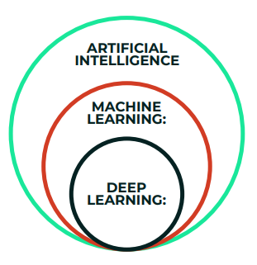
ARTIFICIAL INTELLIGENCE Vs. MACHINE LEARNING Vs. DEEP LEARNING

Slide 6

1. ARTIFICIAL INTELLIGENCE
Science that empowers computers to mimic human intelligence such as decision making, text processing, and visual perception.
AI is a broader field (i.e.: the big umbrella) that contains several subfield such as machine learning, robotics, and computer vision.
Photo Credit: https://pixabay.com/illustrations/artificial-intelligence-brain-think-4111582/

Slide 7
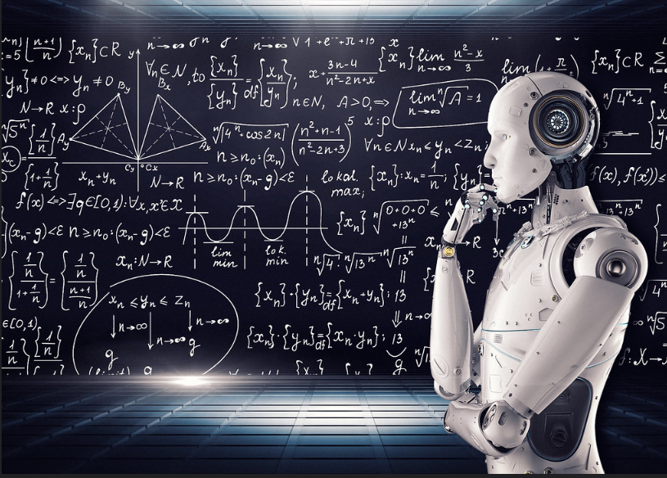
2. MACHINE LEARNING
Machine Learning is a subfield of Artificial Intelligence that enables machines to improve at a given task with experience.
It is important to note that all machine learning techniques are classified as Artificial Intelligence ones. However, not all Artificial Intelligence could count as Machine Learning since some basic Rule-based engines could be classified as AI but they do not learn from experience therefore they do not belong to the machine learning category.
Photo Credit: https://www.flickr.com/photos/mikemacmarketing/30212411048

Slide 8
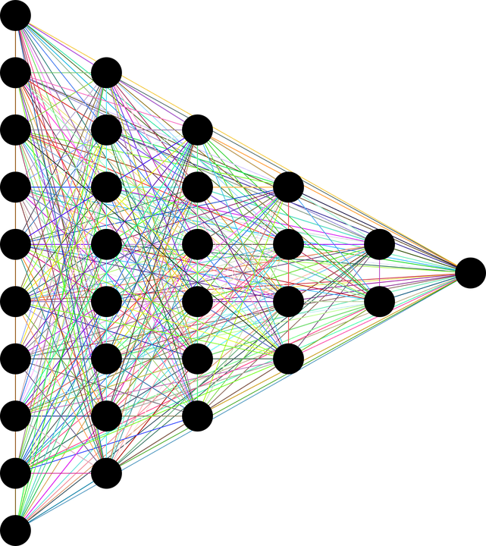
3. DEEP LEARNING
Deep Learning is a specialized field of Machine Learning that relies on training of Deep Artificial Neural Networks (ANNs) using large dataset such as images.
ANNs are information processing models inspired by the human brain.
The human brain consists of billions of neurons that communicate to each other using electrical and chemical signals and enable humans to see, feel, and make decision.
TARGET OUTPUTS
INPUT DATA
DEEP (HIDDEN LAYERS)
Photo Credit: https://pixabay.com/en/neural-network-thought-mind-mental-3816319/

Slide 9
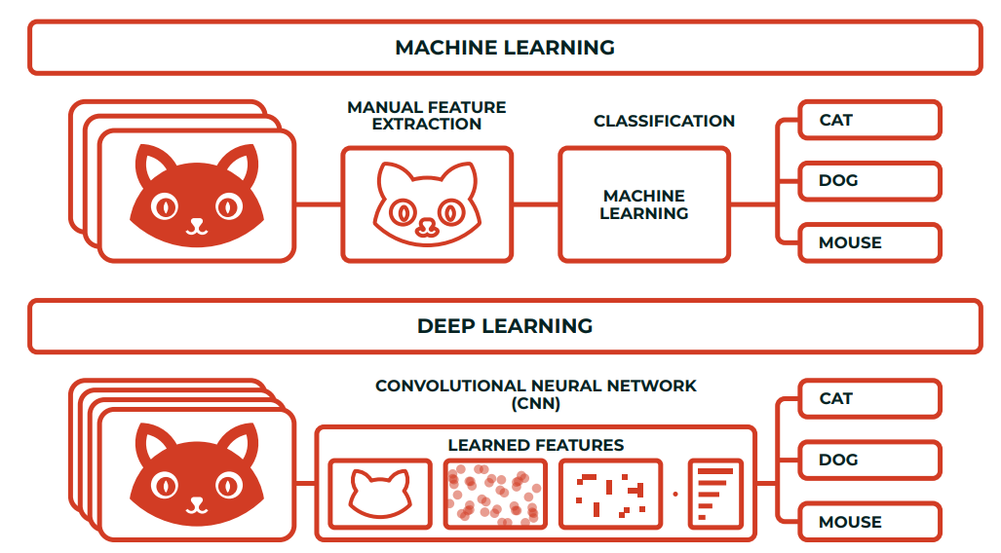
MACHINE VS. DEEP LEARNING
What differentiates deep learning from machine learning techniques is in their ability to extract features automatically:
Machine learning Process: (1) select the model to train, (2) manually perform feature extraction.
Deep Learning Process: (1) Select the architecture of the network, (2) features are automatically extracted by feeding in the training data (such as images) along with the target class (label).

Slide 10
WHAT IS ARTIFICIAL INTELLIGENCE? &
MACHINE LEARNING? – Part #2

Slide 11
MACHINE LEARNING: BIG PICTURE
ARTIFICIAL INTELLIGENCE
Science that enables computers to mimic human intelligence. Subfields: Machine Learning, robotics, and computer vision
MACHINE LEARNING
Subset of AI that enable machines to improve at tasks with experience
SUPERVISED LEARNING
Training algorithms using labeled input/output data.
CLASSIFICATION
REGRESSION
UNSUPERVISED LEARNING
Training algorithms with no labeled data. It attempts at discovering hidden patterns on its own.
CLUSTERING
REINFORCEMENT LEARNING
Algorithm take actions to maximize cumulative reward.

Slide 12
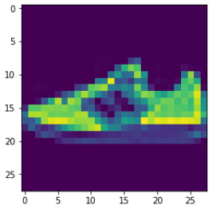
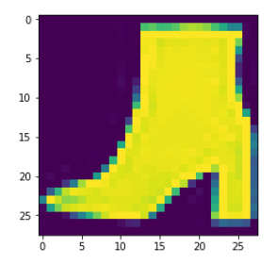
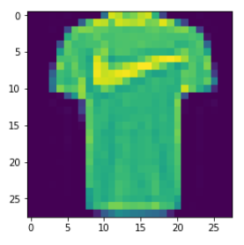
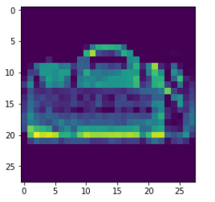

MACHINE LEARNING: SUPERVISED LEARNING
Supervised: used to train algorithms using labeled input and output data.
Performance is assessed by comparing trained model prediction vs. real output.
DESIRED OUTPUT
TARGET CLASSES (LABELS)
y _train
INPUT DATA
$$X _train$$
T-SHIRT/TOP
TROUSER
PULLOVER
DRESS
COAT
SANDAL
SHIRT
SNEAKER
BAG
ANKLE BOOT
MODEL

Slide 13
MACHINE LEARNING: UNSUPERVISED LEARNING
Unsupervised learning: provides the algorithm with no labeled data.
The algorithm attempts at discovering hidden patterns within the training data.
Unsupervised learning methods can analyze complex data that humans might find difficult to interpret.
No feedback!
DATA CLUSTERS
INPUT DATA
MODEL

Slide 14
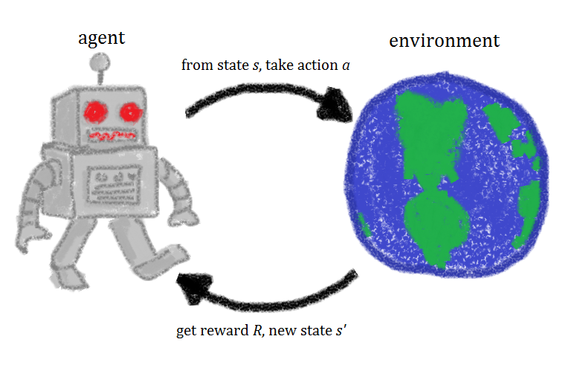

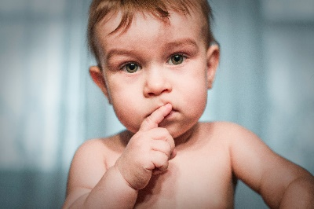
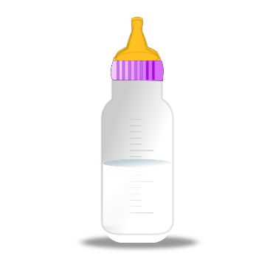
MACHINE LEARNING: REINFORCEMENT LEARNING
Reinforcement learning allows machines take actions to maximize cumulative reward.
Reinforcement algorithms learn by trial and error through reward and penalty.
Two elements: environment and learning agent.
The environment rewards the agent for correct actions.
Based on the reward or penalty, agent improves its environment knowledge to make better decision.
ENVIRONMENT
AGENT
-10 Points
+10 Points
Photo Credit: https://commons.wikimedia.org/wiki/File:Rl_agent.png

Slide 15
AI/ML DATA LINGO – LABELED VS. UNLABELED

Slide 16

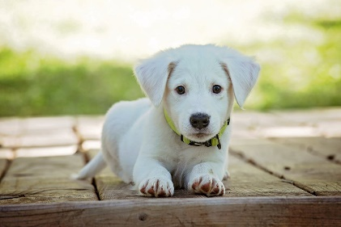
MACHINE LEARNING DATA
Machine Learning models require data to train.
There are generally two types of data that we could use to train machine learning models.
UNLABELED DATASET
LABELED DATASET
Unlabeled data consists of data that does not have explanation (class or tag) associated with it.
Labeled data consists of unlabeled data but with a “class” or “tag” associated with it.
LABEL = “CAT”
LABEL = “DOG”
Photo Credit: https://www.pexels.com/photo/grey-and-white-short-fur-cat-104827/
Photo Credit: https://www.pexels.com/photo/portrait-of-a-dog-257540/

Slide 17
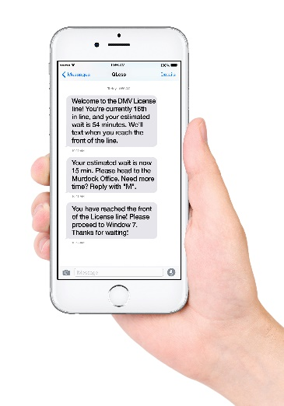
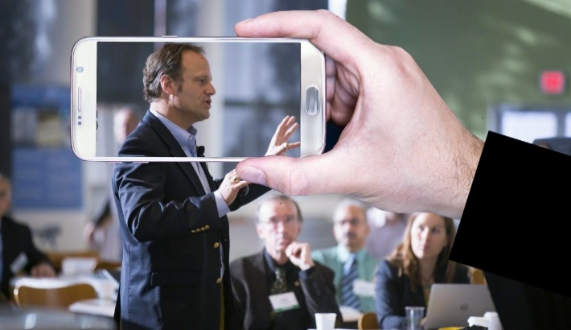

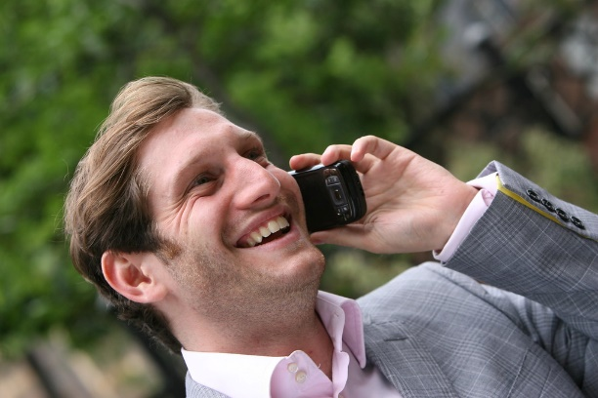

WHERE DOES THIS DATA COME FROM?
Data can come from so many sources such as images, audio, video, and text.
Collecting, structuring and analysing this data is critical for companies to gain customers insights and set their marketing and product strategies.
IMAGE/VIDEO
TEXT (CORPUS)
AUDIO/SOUND
TIMESERIES/SIGNALS
Photo Credit: https://pxhere.com/en/photo/1454351
Photo Credit: https://www.flickr.com/photos/29881930@N00/2086641598
Photo Credit: https://commons.wikimedia.org/wiki/File:Mobile_phone_text_messages.jpg
Photo Credit: https://en.wikipedia.org/wiki/File:Messages_Yosemite.svg
Photo Credit: https://www.pexels.com/photo/blue-and-yellow-graph-on-stock-market-monitor-159888/

Slide 18
GOOD Vs. BAD DATA
GOOD DATA
BAD DATA
Many samples (large number of data points)
Not Biased
Does not contain missing data points
Only contains (relevant) important features
Does not contain duplicate samples
Few samples (small number of data points)
Biased
Contains missing data points
Contains many irrelevant (useless) features
Contains duplicate samples

Slide 19
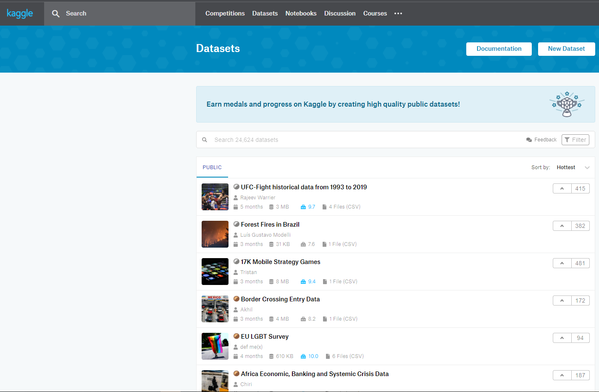
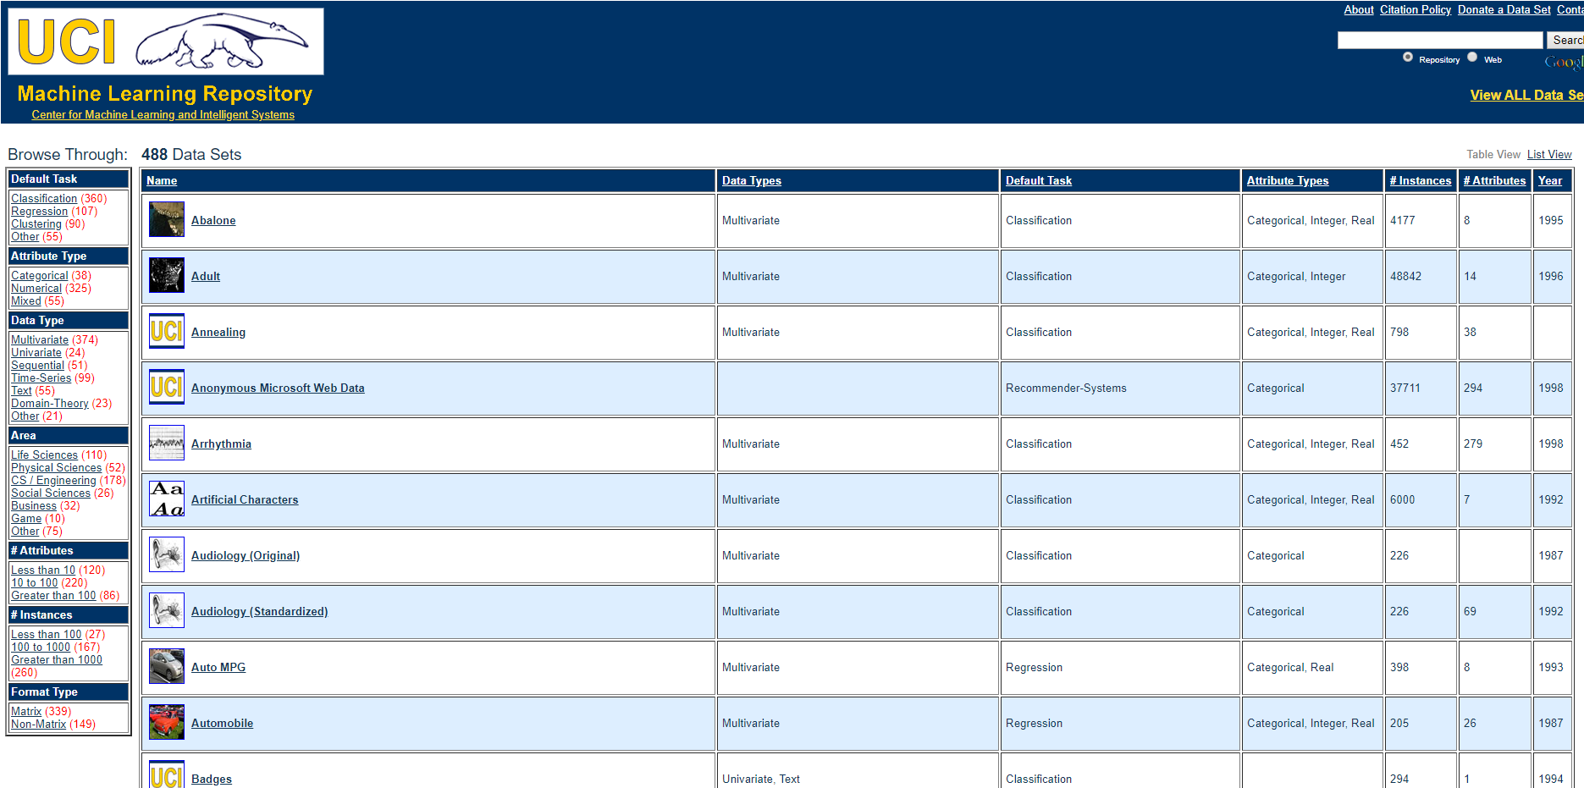
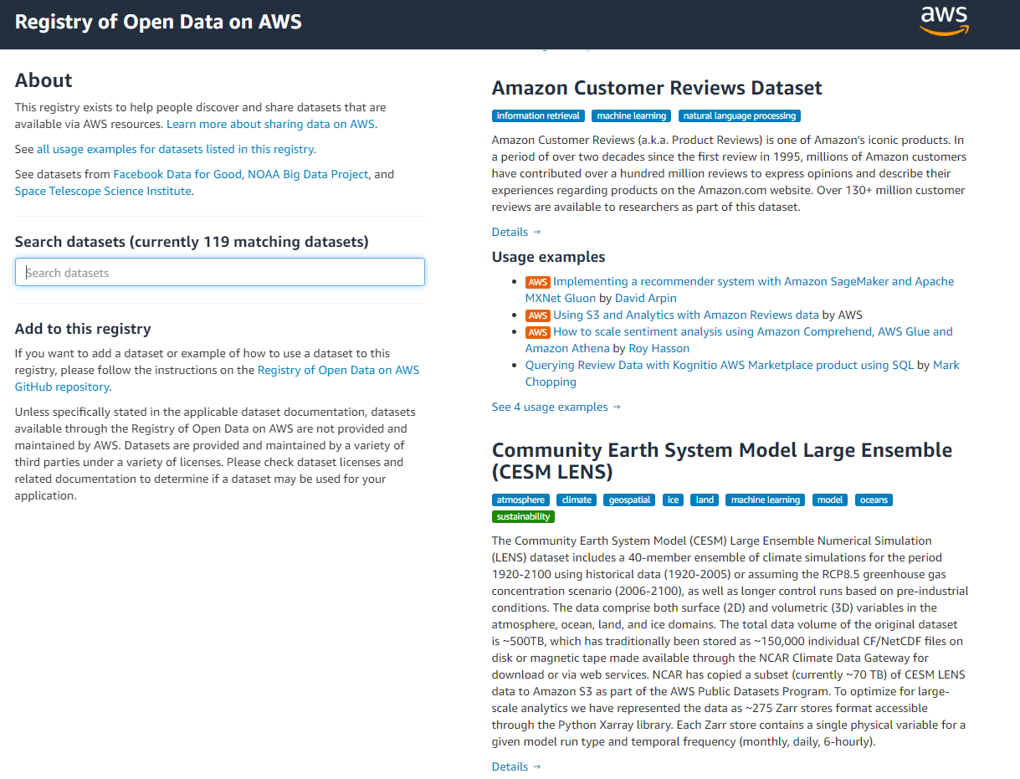
WHERE DOES THIS DATA COME FROM?
Data could also come from multiple sources such as Kaggle, UCI, AWS Dataset, and ImageNet.
ImageNet is an open source repository of images consisting of 21,841 subcategories (classes) and over 14 million images.
Check out website here: https://archive.ics.uci.edu/ml/datasets.php
Check out website here: https://www.kaggle.com/datasets

